Slide 1




Data-Limited Fisheries Toolkit
Evaluating management strategies for data-limited fish species
Running MPs
Lecture 4b, May 2017
Tom Carruthers & Adrian Hordyk .
Nicolas Gutierrez

Slide 2
Agenda
Can / Cant / Needed functions
Calculating TAC or effort recommendations
Sensitivity analysis

Slide 3
Diagnosing data-MP compatibility
In most data-limited fisheries it is likely that some slots in a Data object are missing data and assigned an ‘NA’ value.
DLMtool has a series of functions to check which MPs can be applied to a given dataset:
Can() a list of MPs that can be applied
Cant() a list of MPs that cannot be applied and an explanation of why not
Needed() the additional data needed for every MP that ` can’t be applied

Slide 4
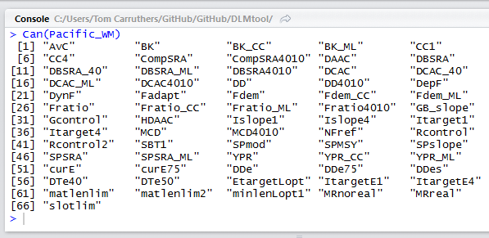
The Can() function
Returns MPs that can be applied to an object of class Data:

Slide 5
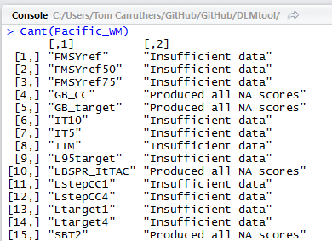
The Cant() function
Returns MPs that can’t be applied to the data and an explanation:

Slide 6
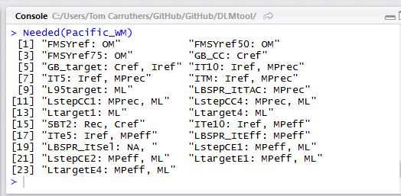
The Needed() function
Returns MPs that can’t be applied to the data and the corresponding data that are needed:

Slide 7

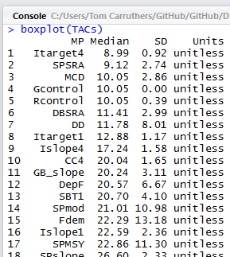
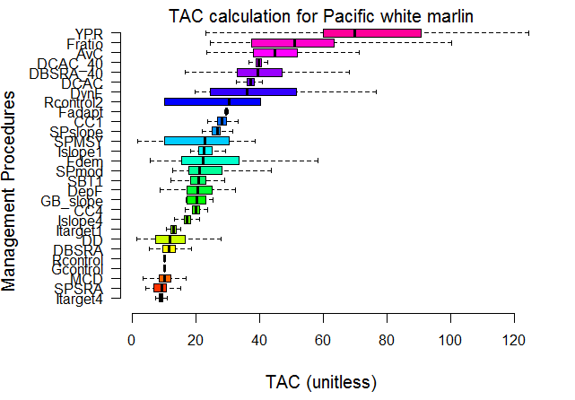
Calculating TACs for a Data object: TAC()

Slide 8

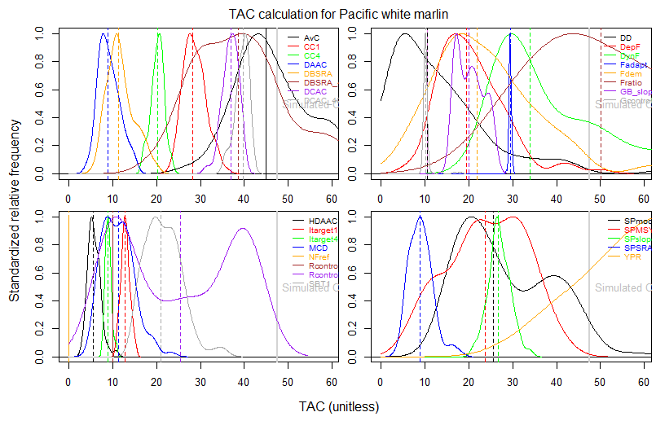
Plot

Slide 9
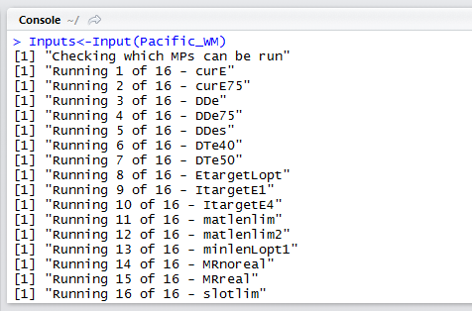
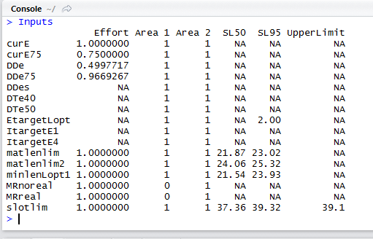
Calculating input recommendations: Input()

Slide 10

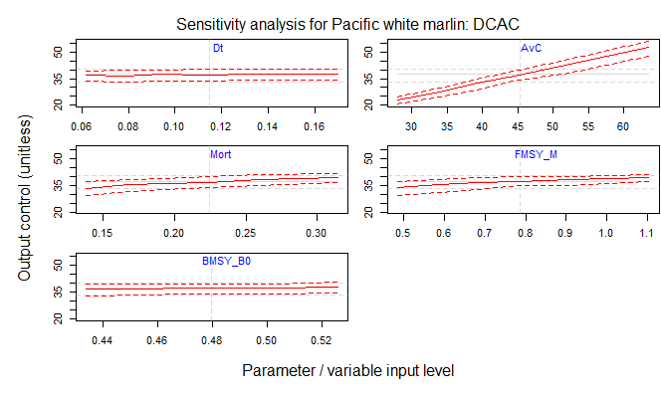
Sensitivity analysis: Sense()

Slide 11
Getting help with Data objects
Cheat sheets for objects: /Help/Cheat sheets/
Examples: /Exercises/Data/CSV/Data_example.csv
R package help: class?Data
Online help: https://dlmtool.github.io/DLMtool/index.html

Slide 12
Handy commands
avail(Class name)
Can(Data object)
Cant(Data object)
Needed(Data object)
TAC(Data object)
Input(Data object)
boxplot(object made by TAC)
plot(object made by TAC)
Sense(Data object, MP)
avail(“Data”)
Can(Red_snapper)
Cant(Red_snapper)
Needed(Red_snapper)
myTAC = TAC(Red_snapper)
Input(Red_snapper)
boxplot(myTAC)
plot(myTAC)
Sense(Red_snapper, “DBSRA”)

